Slide 1
Parallel Computing
Exercise

Slide 2
Outline
Exercises 1 : Serial PI Program
Exercise 2: first OpenMP PI program

Slide 3
Exercises 1 : A recurring example
Numerical integration

Slide 4
static long num_steps = 100000;
double step; int main ()
{ int i; double x, pi, sum = 0.0;
step = 1.0/(double) num_steps;
for (i=0;i< num_steps; i++){
x = (i+0.5)*step;
sum = sum + 4.0/(1.0+x*x);
}
pi = step * sum;
}

Slide 5
Exercise 2
Create a parallel version of the pi program
using a parallel construct.
Pay close attention to shared versus private
variables.
In addition to a parallel construct, you will need the runtime library routines
。int omp_get_num_threads();
。int omp_get_thread_num();
。double omp_get_wtime();
Number of threads in the team
Thread ID or rank
Time in Seconds since a fixed point in the past
49

Slide 6
Example: A simple Parallel pi program
#include <omp.h>
Promote scalar to an array dimensioned by number of threads to avoid race condition.
static long num_steps = 100000;
#define NUM_THREADS 2 void main ()
double step;
{
int i, nthreads; double pi, sum[NUM_THREADS]; step = 1.0/(double) num_steps; omp_set_num_threads(NUM_THREADS);
#pragma omp parallel
{
int i, id,nthrds;
double x;
id = omp_get_thread_num(); nthrds = omp_get_num_threads(); if (id == 0) nthreads = nthrds;
Only one thread should copy the number of threads to the global value to make sure multiple threads writing to the same address don’t conflict.
for (i=id, sum[id]=0.0;i< num_steps; i=i+nthrds) { x = (i+0.5)*step;
sum[id] += 4.0/(1.0+x*x);
}
This is a common trick in SPMD programs to create a cyclic distribution of loop iterations
}
for(i=0, pi=0.0;i<nthreads;i++)pi += sum[i] * step;
}

Slide 7
Algorithm strategy:
The SPMD (Single Program Multiple Data) design pattern
Run the same program on P processing elements where P can be arbitrarily large.
Use the rank … an ID ranging from 0 to (P-1) … to select between a set of tasks and to manage any shared data structures.
This pattern is very general and has been used to support
most (if not all) the algorithm strategy patterns.
MPI programs almost always use this pattern … it is probably the most commonly used pattern in the history of parallel programming.
This pattern is very general and has been used to support
most (if not all) the algorithm strategy patterns.
MPI programs almost always use this pattern … it is probably the most commonly used pattern in the history of parallel programming.
53

Slide 8
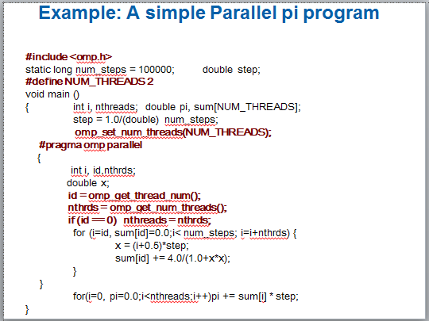
Results*
Original Serial pi program with 100000000 steps ran in 1.83 seconds.
threads | ₁st SPMD
1 | 1.86
2 | 2.53
3 | 2.57
4 | 2.38
54

Slide 9
Why such poor scaling? False sharing
If independent data elements happen to sit on the same cache line, each
update will cause the cache lines to “slosh back and forth” between threads
… This is called “false sharing”.
HW thrd. 0
HW thrd. 1
HW thrd. 2
HW thrd. 3
L1 $ lines
L1 $ lines
Sum[0]
Sum[1]
Sum[2]
Sum[3]
Sum[0]
Sum[1]
Sum[2]
Sum[3]
Core 0
Core 1
Shared last level cache and connection to I/O and DRAM
If you promote scalars to an array to support creation of an SPMD program, the array elements are contiguous in memory and hence share cache lines
… Results in poor scalability.
Solution: Pad arrays so elements you use are on distinct cache lines.
55

Slide 10
Example: eliminate False sharing by padding the sum array
#include <omp.h>
static long num_steps = 100000; double step;
#define PAD 8
#define NUM_THREADS 2
void main ()
// assume 64 byte L1 cache line size
{
int i, nthreads; double pi, sum[NUM_THREADS][PAD]; step = 1.0/(double) num_steps; omp_set_num_threads(NUM_THREADS);
#pragma omp parallel
Pad the array so each sum value is in a different cache line
{
int i, id,nthrds; double x;
id = omp_get_thread_num(); nthrds = omp_get_num_threads(); if (id == 0) nthreads = nthrds;
for (i=id, sum[id]=0.0;i< num_steps; i=i+nthrds) { x = (i+0.5)*step;
sum[id][0] += 4.0/(1.0+x*x);
}
}
for(i=0, pi=0.0;i<nthreads;i++)pi += sum[i][0] * step;
}
56

Slide 11
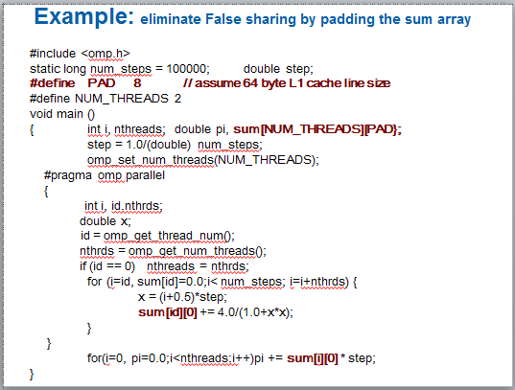
Results*: pi program padded accumulator
Original Serial pi program with 100000000 steps ran in 1.83 seconds.
threads | ₁st SPMD | ₁st SPMD padded
1 | 1.86 | 1.86
2 | 2.53 | 1.01
3 | 2.57 | 0.69
4 | 2.38 | 0.53
*Intel compiler (icpc) with no optimization on Apple OS X 10.7.3 with a dual core (four HW thread) Intel® CoreTM i5 processor at 1.7 Ghz and 4 Gbyte DDR3 memory at 1.333 Ghz.
57

Slide 12
Do we really need to pad our arrays?
Padding arrays requires deep knowledge of the cache architecture. Move to a machine with different sized cache lines and your software performance falls apart.
There has got to be a better way to deal with false sharing.
58

Slide 13
Exercise 3

Slide 14
Example: Pi with a loop and a reduction
#include <omp.h>
static long num_steps = 100000; void main ()
double step;
{ int i; double x, pi, sum = 0.0;
step = 1.0/(double) num_steps;
#pragma omp parallel
Create a team of threads … without a parallel construct, you’ll never have more than one thread
{
Create a scalar local to each thread to hold value of x at the center of each interval
double x;
#pragma omp for reduction(+:sum)
for (i=0;i< num_steps; i++){ x = (i+0.5)*step;
sum = sum + 4.0/(1.0+x*x);
}
Break up loop iterations and assign them to threads … setting up a reduction into sum.
Note … the loop indix is local to a thread by default.
}
pi = step * sum;
}
88

Slide 15
Loops (cont.)
Made schedule(runtime) more useful
can get/set it with library routines
omp_set_schedule() omp_get_schedule()
allow implementations to implement their own schedule kinds
Added a new schedule kind AUTO which gives full freedom to the runtime to determine the scheduling of iterations to threads.
Allowed C++ Random access iterators as loop control
variables in parallel loops
91

Slide 16
Exercise 4

Slide 17
Example: Using a critical section to remove impact of false sharing
#include <omp.h>
static long num_steps = 100000;
#define NUM_THREADS 2 void main ()
double step;
{ double pi; step = 1.0/(double) num_steps;
omp_set_num_threads(NUM_THREADS);
#pragma omp parallel
{
int i, id,nthrds; double x, sum; id = omp_get_thread_num(); nthrds = omp_get_num_threads(); if (id == 0) nthreads = nthrds;
Create a scalar local to each thread to accumulate partial sums.
id = omp_get_thread_num();
nthrds = omp_get_num_threads();
for (i=id, sum=0.0;i< num_steps; i=i+nthreads){ x = (i+0.5)*step;
sum += 4.0/(1.0+x*x);
No array, so no false sharing.
No array, so no false sharing.
No array, so no false sharing.
}
#pragma omp critical
pi += sum * step;
Sum goes “out of scope” beyond the parallel region … so you must sum it in here. Must protect summation into pi in a critical region so updates don’t conflict
}
}
69

Slide 18
Example: Using a critical section to remove impact of false sharing
#include <omp.h>
static long num_steps = 100000;
#define NUM_THREADS 2 void main ()
double step;
{ double pi; step = 1.0/(double) num_steps;
omp_set_num_threads(NUM_THREADS);
#pragma omp parallel
{
int i, id,nthrds; double x; id = omp_get_thread_num();
nthrds = omp_get_num_threads(); if (id == 0) nthreads = nthrds;
id = omp_get_thread_num();
nthrds = omp_get_num_threads();
for (i=id, sum=0.0;i< num_steps; i=i+nthreads){ x = (i+0.5)*step;
#pragma omp critical pi += 4.0/(1.0+x*x);
}
Be careful where you put a critical section
What would happen if you put the critical section inside the loop?
What would happen if you put the critical section inside the loop?
What would happen if you put the critical section inside the loop?
}
pi *= step;
}
71

Slide 19
Example: Using an atomic to remove impact of false sharing
#include <omp.h>
static long num_steps = 100000;
#define NUM_THREADS 2 void main ()
double step;
{ double pi; step = 1.0/(double) num_steps;
omp_set_num_threads(NUM_THREADS);
#pragma omp parallel
{
int i, id,nthrds; double x, sum; id = omp_get_thread_num(); nthrds = omp_get_num_threads(); if (id == 0) nthreads = nthrds;
Create a scalar local to each thread to accumulate partial sums.
id = omp_get_thread_num();
nthrds = omp_get_num_threads();
for (i=id, sum=0.0;i< num_steps; i=i+nthreads){ x = (i+0.5)*step;
sum += 4.0/(1.0+x*x);
No array, so no false sharing.
No array, so no false sharing.
No array, so no false sharing.
}
sum = sum*step;
#pragma atomic
pi += sum ;
Sum goes “out of scope” beyond the parallel region … so you must sum it in here. Must protect summation into pi so updates don’t conflict
}
72

